Slide 1
ML for covid-19 diagnosis
Aksh Garg
Senior at Palos Verdes Peninsula HS

Slide 2
Why CT-Scan Diagnostics?
PCR testing is limited to certain regions of the world.
With the rapid increase in demand, it’s not always sufficient
On the other hand, an X-ray/CT-Scan machine is nearly universally accessible.
The bottleneck occurs in the radiologists available for diagnosis
Eliminate the dependence on radiologists → Cheaper, faster diagnostics

Slide 3
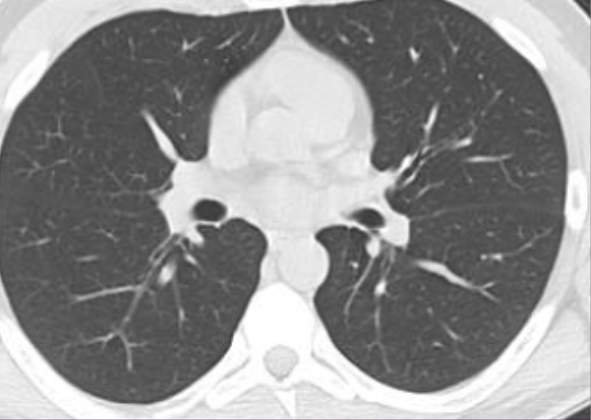
Which patient do you think has COVID?

Slide 4
ML PIPLEINE

Slide 6
Training

Slide 7
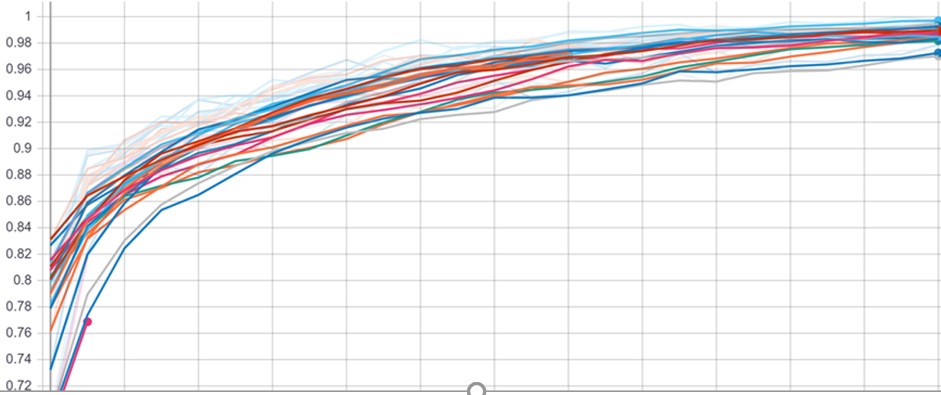
Accuracy in Diagnosis
Training Time

Slide 8
Testing

Slide 9
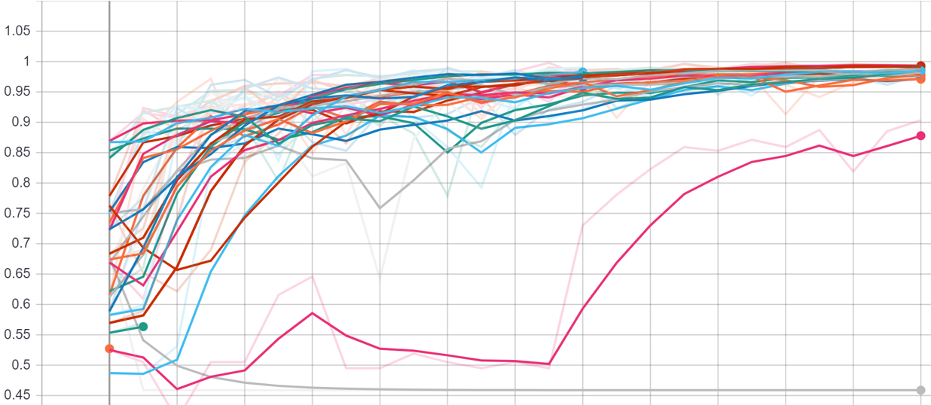
Accuracy in Diagnosis
Training Time

Slide 10
Visualization

Slide 11
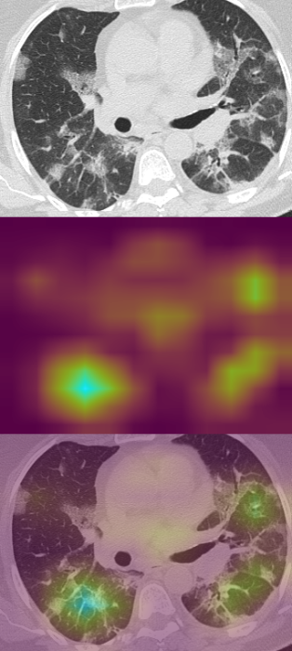

Slide 12
Overall Picture
Accomplished == The best models for diagnosis. Faster and accessible diagnostics
Accomplished = Way of visualizing what models are looking at
To do == Generalize These Models
Working on that by generating new images for COVID-19 computationally

